Slide 1


Zara
Product Insights
Using PowerBI
PRESENTED BY
Deepthisree

Slide 2

Presentation Objective
The objective of this project is to design an interactive Power BI dashboard that provides clear insights into Zara’s product catalog.
This dashboard helps business stakeholders understand:
  Product distribution across categories
  Pricing structure and pricing range
  Promotion patterns
  Seasonal product analytics
  Product positioning insights (Aisle vs End-cap)
The goal is to support data-driven decision-making in retail operations.

Slide 3

Dataset Description
The dataset sourced from Kaggle's Fashion / Retail collection includes 252 product listings, detailing pricing, promotions, and seasonal trends to drive data-driven insights for Zara's product catalog.
  Key Columns:
    Product ID
    Product Category
    Price
    Promotion (Yes/No)
    Seasonal (Yes/No)
    Product Position (Aisle / End-cap)
    Section
  Data Type: Product listing data (not sales data)
The dataset helps analyze Zara’s assortment, pricing, and product strategy.

Slide 4

KPIs Used
  This section outlines the key performance indicators tracked within the Zara Product Insights Dashboard, which provide vital metrics for understanding product performance and trends
.
The dashboard includes the following key performance indicators:
  Total Products: Total number of items listed
  Products on Promotion: Count of discounted/promo items
  Average Price: Mean price across all products
  Seasonal Products: Number of items marked as seasonal
These KPIs summarize the overall product portfolio at a glance.

Slide 5
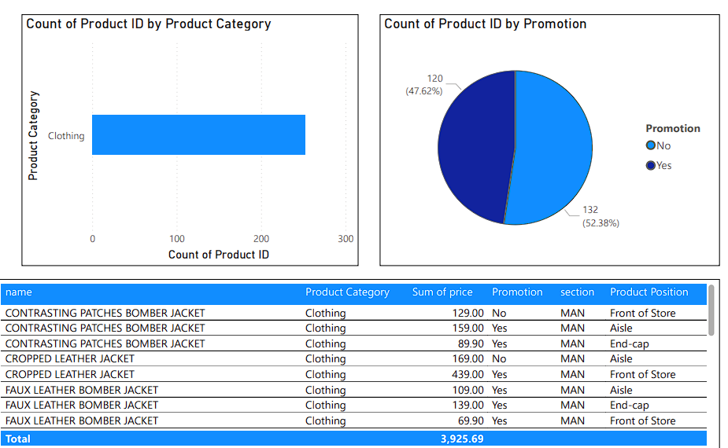
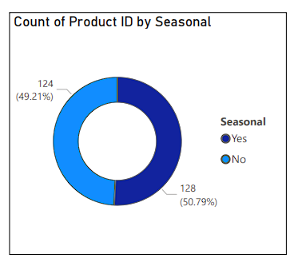
Dashboard Visuals

Slide 6
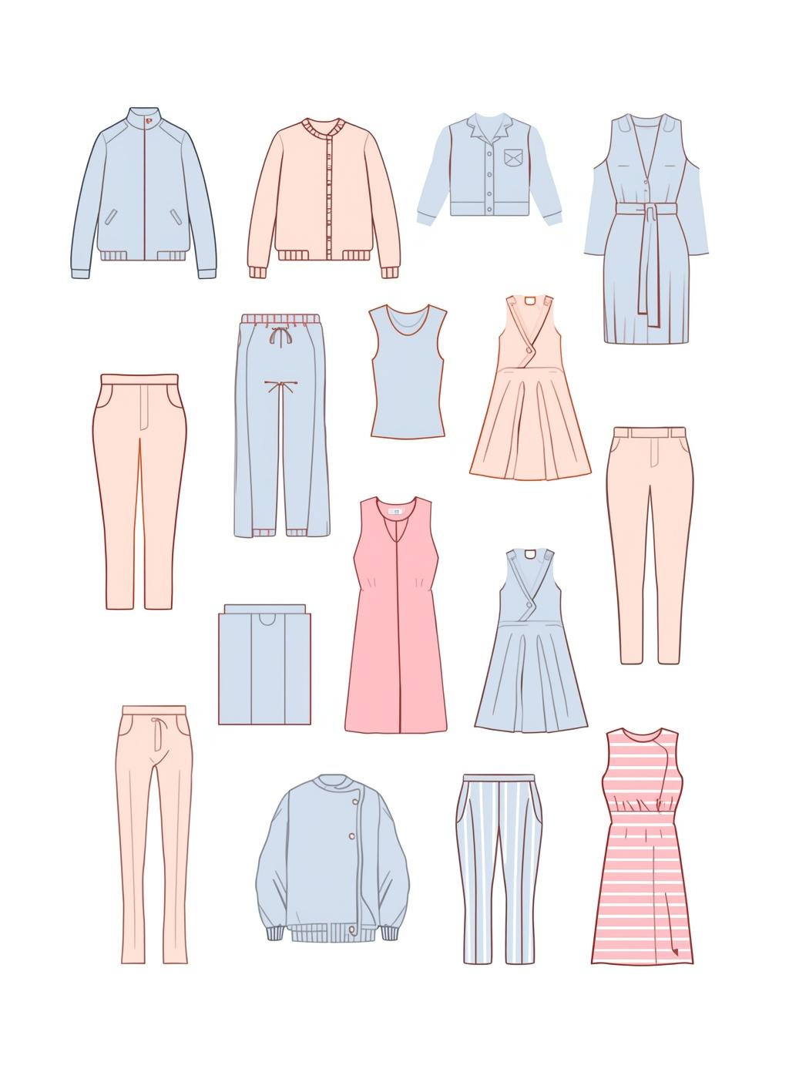
Key Insights
This section highlights critical findings derived from the dashboard analysis, showcasing significant trends and patterns in Zara’s product offerings that inform strategic decisions.
Based on the dashboard analysis:
  The Clothing category contains the highest number of products
  A significant portion of items are seasonal, indicating trend-based inventory
  A large number of products are on promotion, suggesting aggressive marketing
  Price range varies widely, from low-cost basics to premium apparel
  Some categories (like Jackets or Dresses) show higher average prices than others
  Product positions (Aisle vs End-cap) show different category distributions
These insights help plan pricing, inventory, and promotions.

Slide 7

Conclusion
  Power BI enabled the creation of a clear, interactive dashboard for Zara’s product data
  The analysis highlights important patterns in product pricing, promotions, and seasonal trends
  Category and position insights support inventory optimization
  Retail teams can use this dashboard to make informed business decisions
  The project demonstrates effective data visualization and dashboard development skills

